Slide 1

Deep Neural Network (DNN)
Module 2: Artificial Neuron and Perceptron

Slide 2
Part 1: The Brain: Our Inspiration
Understanding the Biological Blueprint

Slide 3

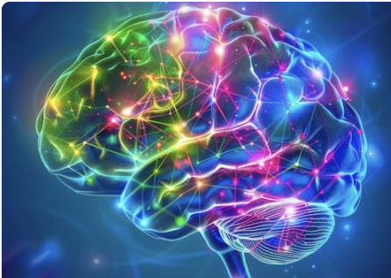
How Do Humans Learn?
Learning Through Association
The human brain is the primary inspiration for ANNs.
Humans learn, solve problems, and recognize patterns.
A core theory is Associationism: we learn by associating new ideas with existing ones.
ANNs are a computational model inspired by this process.

Slide 4
Observation: The Brain
A Massively Parallel System
The brain is a mass of interconnected neurons.
It functions as a massively parallel computational system.
This parallel structure is what allows it to perform complex tasks so quickly, despite its components being slow.

Slide 5
Brain Scale Estimates
Estimates of Scale
Number of neurons: ~1010 (10 billion)
Connections per neuron: ~104 to 105 (10k - 100k)
Neuron switching time: ~0.001 second (1 millisecond)

Slide 6
The Brain's Inference
The 100-Step Puzzle
Scene recognition time: ~0.1 to 1 second.
Neuron switching time: ~0.001 second.
Conclusion: The brain must perform complex tasks in ~100 inference steps.
This is only possible through massive parallel computation.

Slide 7
Part 2: The Biological Neuron
The Original Processing Element

Slide 8
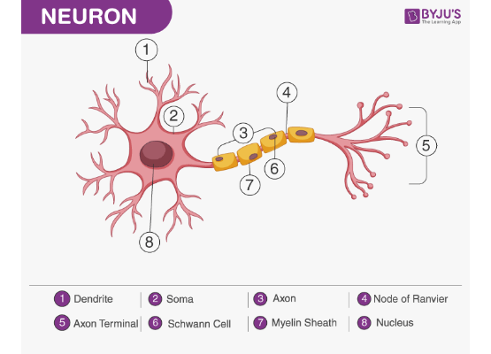
Biological Neuron Structure
Signal Flow Direction
Electrical impulses travel from other neurons to the dendrites.
They are processed in the Cell Body (Soma).
An output signal is transmitted down the Axon to the axon terminals (Synapses).

Slide 9
Key Components of a Neuron
Components and Functions
Dendrites: Receive signals (inputs) from other neurons.
Cell Body (Soma): Processes incoming signals (integration).
Axon: Transmits the output signal (output).
Synapses: Connection points to other neurons, where signals are passed.

Slide 10
Biological Neuron Function
Receive → Integrate → Fire
1. Receive: Collects thousands of signals from other neurons via its dendrites.
2. Integrate: The cell body sums up these incoming signals.
3. Fire: If the integrated signal exceeds a biological threshold, the neuron fires an output signal.

Slide 11
Part 3: The Artificial Neuron
[ASSIGNMENT-REQUIRED]
Part 3: The Artificial Neuron
The Mathematical Model

Slide 12
Motivation for Artificial Neurons
A Simplified Computational Model
A processing element inspired by the biological neuron.
Each artificial neuron will perform a basic computation.
Like the brain, the interconnections between neurons store the knowledge it learns.
This knowledge is stored as numerical values called parameters or weights.

Slide 13
Jargon: What are "Parameters"?
The "Knobs" of the Model
Parameters are the numbers that the model "learns" from the data.
They represent the "knowledge" stored in the model.
In a neural network, the weights and biases are the parameters.
"Training a model" is the process of finding the best possible values for these parameters.

Slide 14
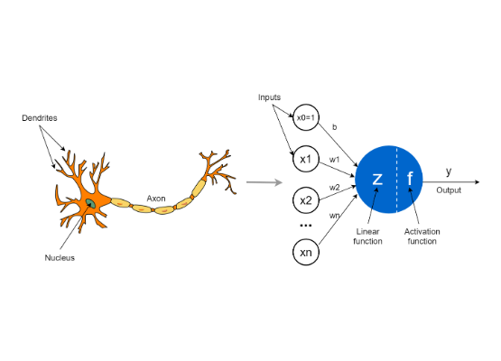
Artificial Neuron Diagram
A Simple Processor
Inputs (x): Numerical values from data (or previous neurons).
Neuron (N): The processing unit that performs a computation.
Output (ŷ): The single numerical output of the neuron.

Slide 15
Jargon: Weights vs. Bias
The Two Types of Parameters
Weight (w): Represents the importance of an input.
Bias (b): An "offset" that controls how easy it is for the neuron to fire.

Slide 16
Components Explained
Inputs, Weights, and Bias
Inputs (xi): The features of our data.
Weights (wi): Parameters that show the importance of each input. This is the "knowledge" the neuron learns.
Bias (b): A special parameter that acts like an "offset" or "threshold" for firing.

Slide 17
Jargon: What is a "Weighted Sum"?
[ASSIGNMENT-REQUIRED]
How Neurons "Listen"
It's the first step of the neuron's calculation.
You take each input, multiply it by its "importance" (the weight), and then sum them all together.
This single number combines all inputs into one value.

Slide 18
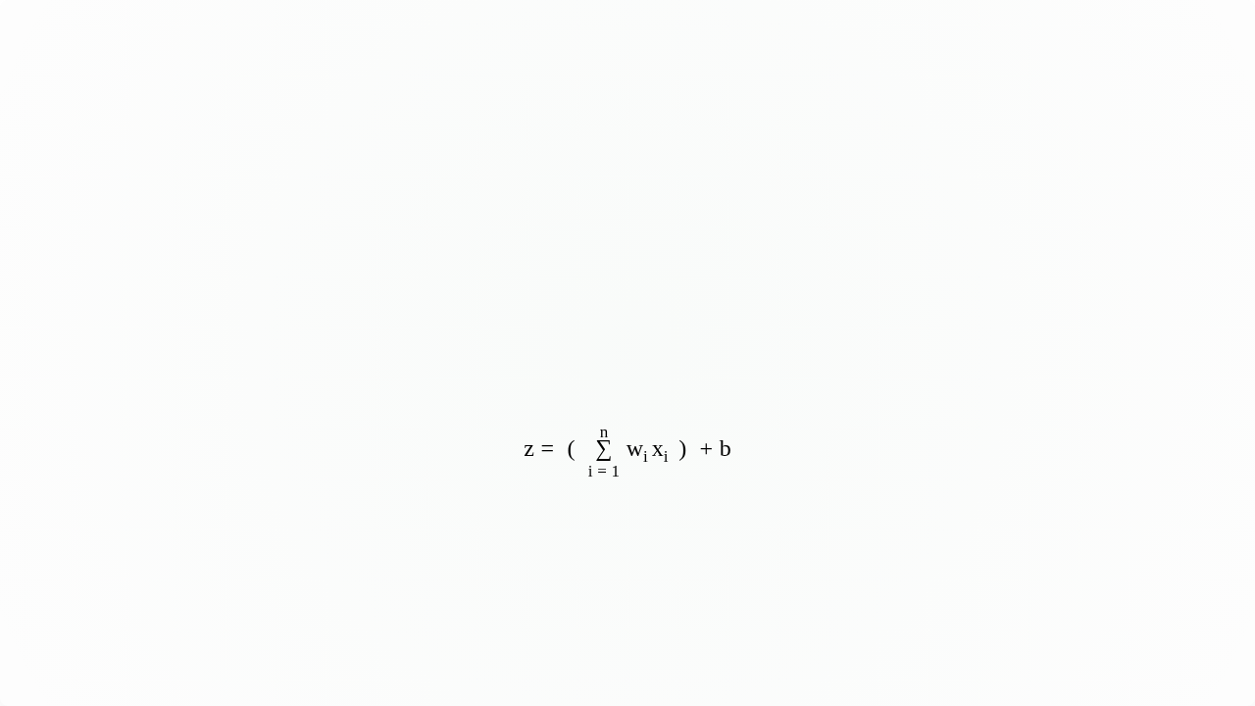
Mathematical Operation: Weighted Sum
[ASSIGNMENT-REQUIRED]
Step 1: The Weighted Sum (z)
The neuron first computes a weighted sum of its inputs.
This is the core of "linear" models.
This sum 'z' is the "integrated signal" before the "firing" decision.

Slide 19
Jargon: "Activation Function"
[ASSIGNMENT-REQUIRED]
The "Firing" Decision
This is the neuron's "decision" mechanism.
It's the second step of the calculation, applied *after* the weighted sum.
It takes the weighted sum (z) and decides what the final output (ŷ) should be.

Slide 20
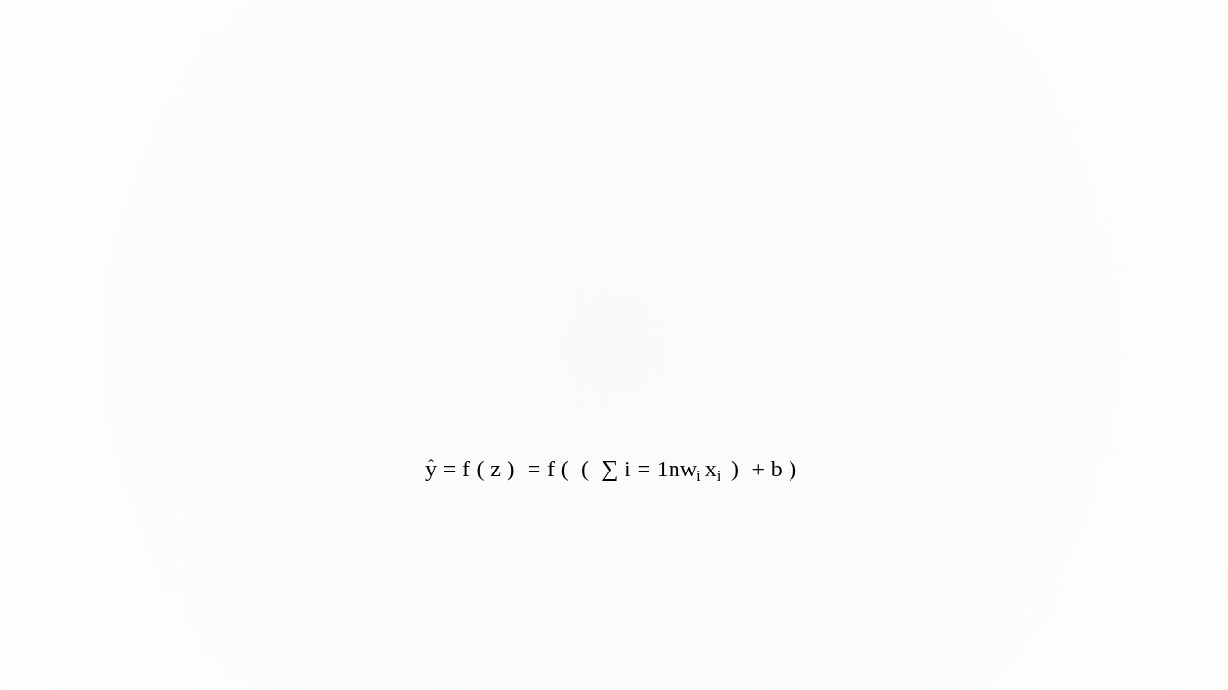
Mathematical Operation: Activation
[ASSIGNMENT-REQUIRED]
Step 2: The Activation Function (f)
The weighted sum 'z' is then passed through an activation function 'f'.
This function makes the "firing decision" and produces the final output.

Slide 21
Jargon: "Forward Computation"
[ASSIGNMENT-REQUIRED]
(or "Forward Pass")
This is the *entire process* of getting a prediction from an input.
It's called "forward" because information flows forward (from input to output).
Step 1: Calculate the Weighted Sum (z).
Step 2: Apply the Activation Function (f) to 'z' to get the final output (ŷ).
This is the "thinking" or "predicting" part of the neuron.

Slide 22
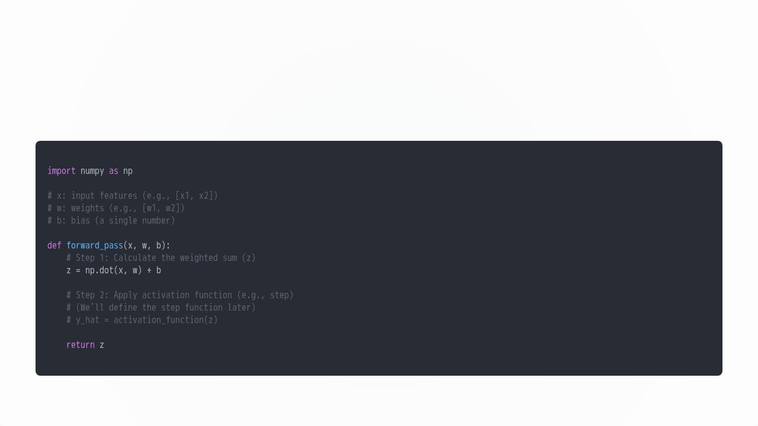
Forward Computation: NumPy Code
[ASSIGNMENT-REQUIRED]
NumPy Implementation

Slide 23
Part 4: Biological vs. Artificial
A Comparison

Slide 24
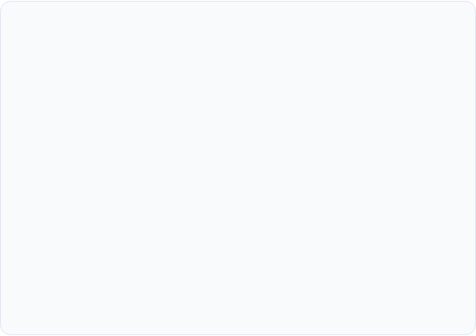
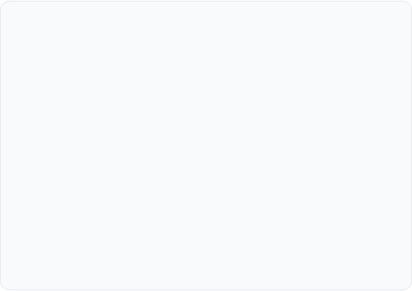
Biological vs. Artificial Neurons
Biological Neuron
Artificial Neuron
Complex biochemical processes
Simple mathematical model
Analog signal processing
Digital computation
Parallel and asynchronous
Often parallel, but synchronous
Fault tolerant
Deterministic behavior
Learns through experience
Learns through algorithms

Slide 25
Part 5: Artificial Neural Networks (ANN)
From Neurons to Networks

Slide 26
What is an ANN?
A Network of Processors
A computational model inspired by the human brain.
It consists of many interconnected neurons that process information.
These networks can learn patterns from data through a training process.
They are powerful tools capable of approximating very complex functions.

Slide 27
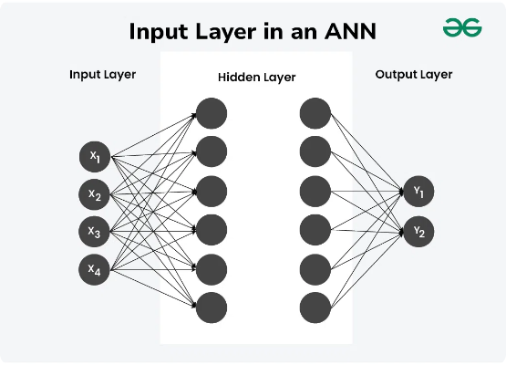
ANN Architecture
Layers of Neurons
Input Layer: Receives the raw features (e.g., pixels, house size).
Hidden Layers: One or more layers of neurons that learn representations of the data.
Output Layer: The final layer that produces the prediction (e.g., "cat", "price").

Slide 28
Jargon: "Feed-Forward"
A One-Way Street
A "feed-forward" network is one where information flows in one direction.
Data flows from Inputs → to Hidden Layers → to Output.
There are no loops, and information never flows backward.

Slide 29
Information Flow in ANNs
Connection Types
Feed-forward: The simplest type. Information flows one way, from input to output. (e.g., Perceptrons, MLPs).
Recursive (Recurrent): Connections can form loops, creating "memory." (e.g., RNNs, for sequence data).
Self-loop: A neuron's output can feed back into its own input.

Slide 30
Properties of ANNs
Key Characteristics
Many neuron-like threshold switching units.
Many weighted interconnections among units.
Highly parallel and distributed process (PDP).
Emphasis on tuning parameters (weights) automatically through learning.

Slide 31
Part 6: When to Consider ANNs
Choosing the Right Tool

Slide 32
When to Use ANNs: Input Data
Problem Characteristics
Input is high-dimensional (e.g., raw sensor input, images, text).
Data is possibly noisy (contains errors or inconsistencies).
Output can be discrete (classification), real-valued (regression), or a vector of values.

Slide 33
When to Use ANNs: Problem Type
Function and Interpretability
The form of the target function is unknown or highly complex.
Human readability or explainability of the result is unimportant.
If you can solve a problem with a simple model (like linear regression), you should! Use ANNs for complex problems.

Slide 34
Real-World Examples
Where ANNs Excel
Speech phoneme recognition: High-dim, noisy audio data.
Image classification: High-dim pixel data, complex function.
Financial prediction: High-dim, noisy market data.

Slide 35
Part 7: Connectionism
The Philosophy Behind ANNs

Slide 36
Connectionist Machines
A "Connectionist" Approach
Neural networks are connectionist machines.
They are composed of a network of simple processing elements (neurons).
All "world knowledge" is stored in the connections between these elements.

Slide 37
Connectionism Principles
Core Ideas
Intelligence emerges from many simple processing neurons.
Knowledge is stored in the connection weights.
Learning is the process of modifying these connection strengths.
Parallel Distributed Processing (PDP) is the mode of computation.

Slide 38
Part 8: The Perceptron
[ASSIGNMENT-REQUIRED]
Part 8: The Perceptron
The Simplest Neural Network

Slide 39
Perceptron: Introduction
[ASSIGNMENT-REQUIRED]
The Original Artificial Neuron
The Perceptron is the simplest form of an artificial neuron.
It was introduced by Frank Rosenblatt in 1958.
It's a model for binary classification (two classes, e.g., 0 or 1).
The intuition from the Perceptron is the basis for your assignment.

Slide 40
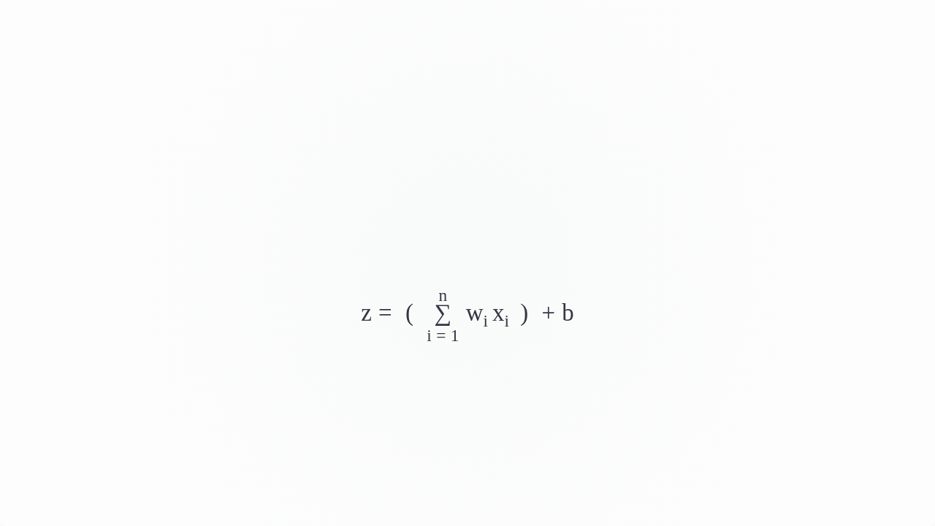
Perceptron Mathematical Model
[ASSIGNMENT-REQUIRED]
Weighted Sum + Threshold
It computes the weighted sum 'z' (just as we saw).
It then applies a step activation function.

Slide 41
Jargon: What is a "Step Function"?
[ASSIGNMENT-REQUIRED]
An "All-or-Nothing" Switch
It is the simplest activation function.
It models an "all-or-nothing" decision, just like the biological neuron's "firing" threshold.
If the input (z) is above a threshold (e.g., 0), output 1 (ON).
If the input (z) is below the threshold, output 0 (OFF).

Slide 42
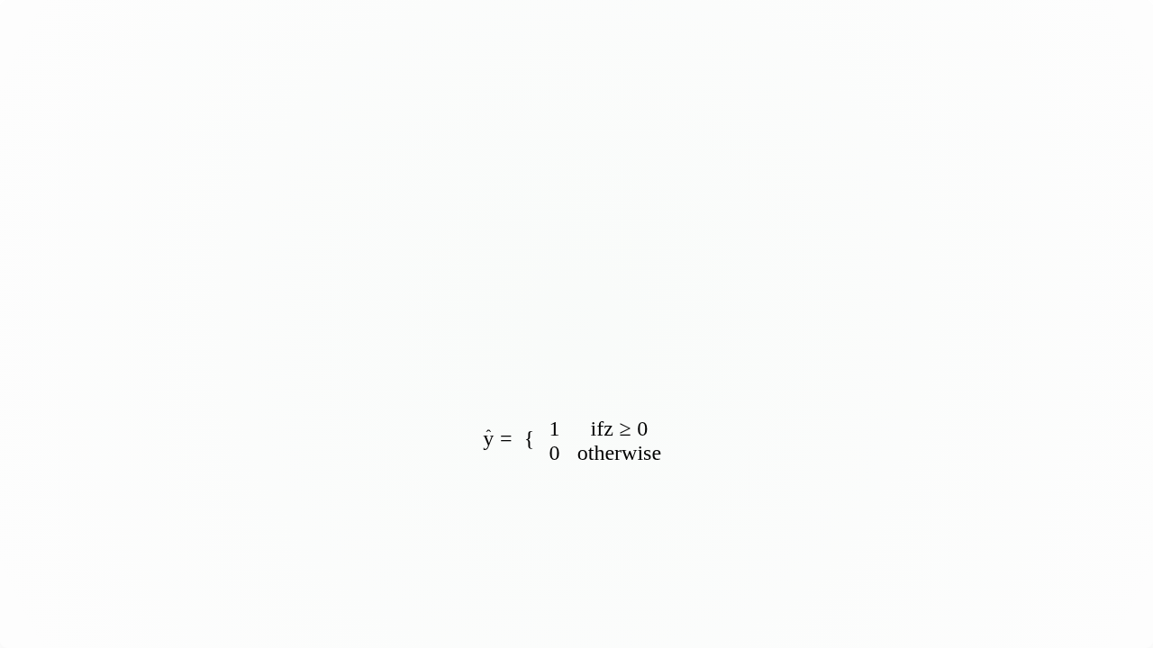
The Step Activation Function
[ASSIGNMENT-REQUIRED]
The "Firing" Decision Rule
The Perceptron uses a step function as its activation 'f'.
This creates a binary output (0 or 1).

Slide 43
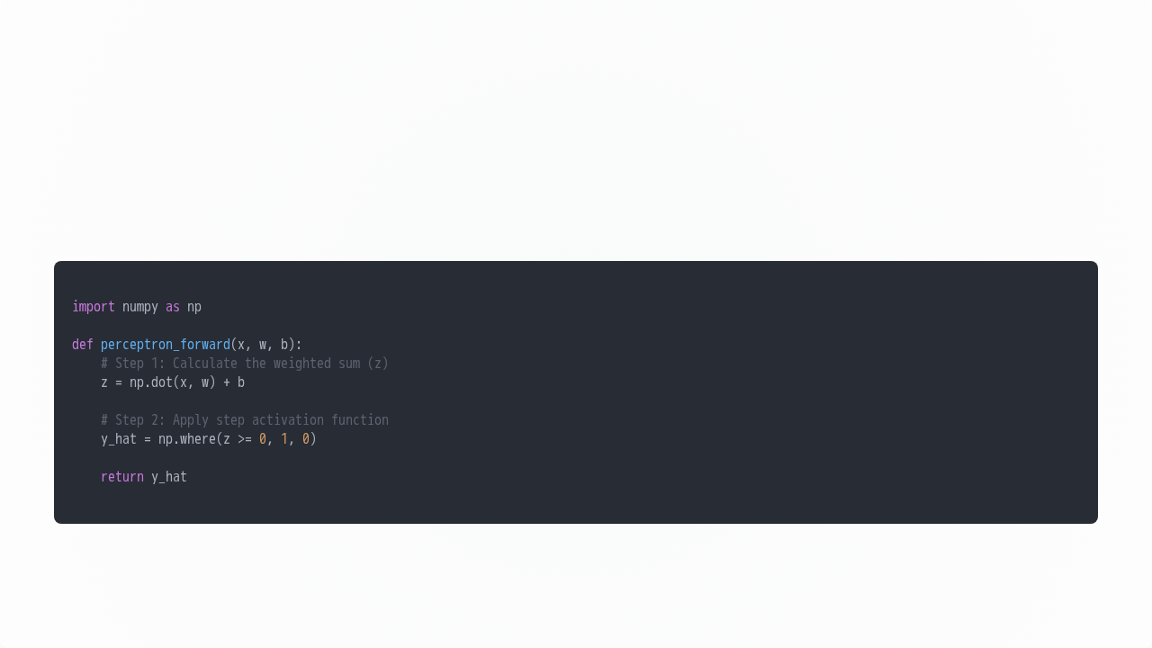
Perceptron Forward Pass: NumPy Code
[ASSIGNMENT-REQUIRED]
NumPy Implementation (Step Function)

Slide 44
Part 9: Perceptrons as Logic Gates
[ASSIGNMENT-REQUIRED]
Part 9: Perceptrons as Logic Gates
Building Simple Boolean Functions

Slide 45
Jargon: "Decision Boundary"
The "Fence" in the Data
This is the line (or surface) that the model learns, to separate the different classes.
On one side of the line, the model predicts "Class 0".
On the other side, it predicts "Class 1".

Slide 46
Representing Logic Gates
Linear Decisions
Boolean functions can be seen as simple classification problems.
A perceptron creates a linear decision boundary.
Our strategy is to find the parameters (w1, w2, and b) that correctly separate the 0s from the 1s.

Slide 47
Perceptron for AND Gate (Data)
[ASSIGNMENT-REQUIRED]
AND Gate Truth Table
x1 | x2 | t (Target)
0 | 0 | 0
0 | 1 | 0
1 | 0 | 0
1 | 1 | 1

Slide 48

Perceptron for AND Gate (Solution)
[ASSIGNMENT-REQUIRED]
One Possible Solution
w1 = 1
w2 = 1
b = -1.5
Check:
(0,0) → 1*0 + 1*0 - 1.5 = -1.5 (Out: 0) ✅
(0,1) → 1*0 + 1*1 - 1.5 = -0.5 (Out: 0) ✅
(1,0) → 1*1 + 1*0 - 1.5 = -0.5 (Out: 0) ✅
(1,1) → 1*1 + 1*1 - 1.5 = +0.5 (Out: 1) ✅

Slide 49
Perceptron for OR Gate (Data)
[ASSIGNMENT-REQUIRED]
OR Gate Truth Table
x1 | x2 | t (Target)
0 | 0 | 0
0 | 1 | 1
1 | 0 | 1
1 | 1 | 1

Slide 50
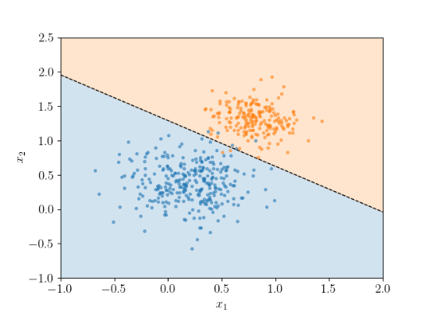
Perceptron for OR Gate (Solution)
[ASSIGNMENT-REQUIRED]
One Possible Solution
w1 = 1
w2 = 1
b = -0.5
Check:
(0,0) → 1*0 + 1*0 - 0.5 = -0.5 (Out: 0) ✅
(0,1) → 1*0 + 1*1 - 0.5 = +0.5 (Out: 1) ✅
(1,0) → 1*1 + 1*0 - 0.5 = +0.5 (Out: 1) ✅
(1,1) → 1*1 + 1*1 - 0.5 = +1.5 (Out: 1) ✅

Slide 51
Exercise: NOR and NAND Gates
[ASSIGNMENT-REQUIRED]
Find the Parameters
Exercise 1: NOR Gate
(Output is 1 only for (0,0))
Try to find w1, w2, and b.
Exercise 2: NAND Gate
(Output is 0 only for (1,1))
Try to find w1, w2, and b.

Slide 52
Part 10: Perceptron Learning Algorithm
[ASSIGNMENT-REQUIRED]
Part 10: Perceptron Learning Algorithm
Learning Weights from Data

Slide 53
Jargon: What does "Converge" Mean?
Finding a Stable Solution
To "converge" means the algorithm has found a solution and stopped changing.
For the Perceptron, this means it has found a "fence" (decision boundary) that correctly separates all data points.
If an algorithm *doesn't* converge, it means it will loop forever, never finding a perfect solution.

Slide 54
PLA: Overview
[ASSIGNMENT-REQUIRED]
Learning Parameters Automatically
Goal: Automatically find weights (w) and bias (b) that correctly classify all training data.
Intuition:
1.
Start with random weights.
2.
Take one data point.
3.
If the prediction is correct, do nothing.
4.
If the prediction is wrong, update the weights to fix it.
This algorithm is guaranteed to converge *if* the data is linearly separable.

Slide 55
Jargon: What is a "Learning Rate" (η)?
[ASSIGNMENT-REQUIRED]
The "Step Size" of Learning
The Learning Rate (Greek letter eta: η) is the "step size" for the learning algorithm.
It controls how much we update the weights after a mistake.
High LR (e.g., 1.0): Big, fast steps. (Risky, might "overshoot" the solution).
Low LR (e.g., 0.01): Tiny, slow steps. (Safe, but takes a very long time).

Slide 56
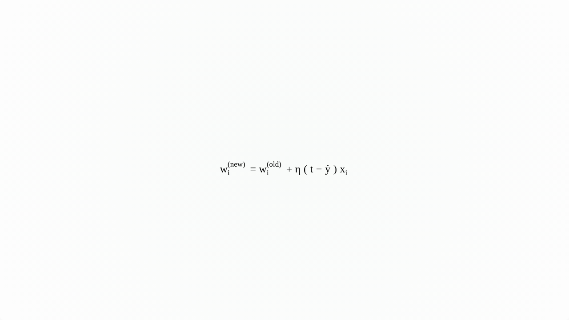
PLA: Weight Update Rule
[ASSIGNMENT-REQUIRED]
How to Update Weights (w)
If ŷ ≠ t (a mistake is made), update the weight wi:
η (eta): The "learning rate" (e.g., 0.1), controls the step size.
(t - ŷ): The error. It will be (+1) or (-1).
xi: The input feature.

Slide 57
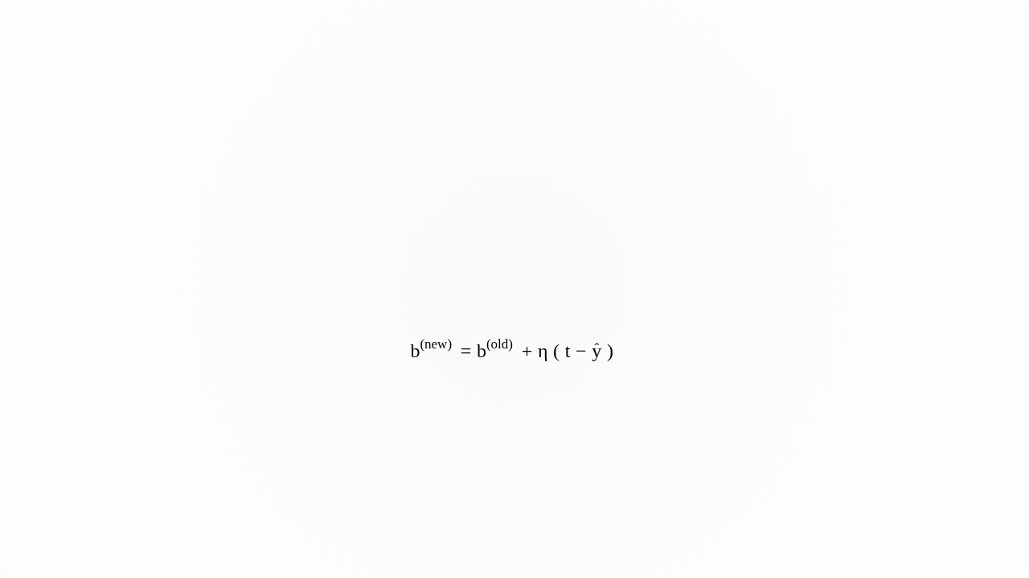
PLA: Bias Update Rule
[ASSIGNMENT-REQUIRED]
How to Update Bias (b)
The bias 'b' is updated similarly, but without the xi term.
This is because the bias is like a weight for an input that is always 1.

Slide 58
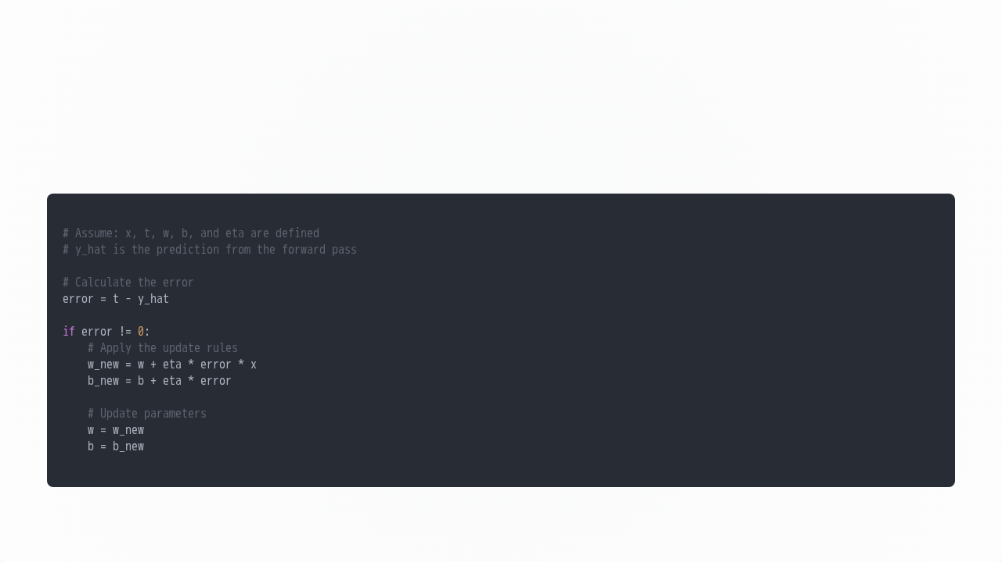
PLA: NumPy Code Snippet
[ASSIGNMENT-REQUIRED]
NumPy Implementation (Update Step)

Slide 59
Jargon: What is an "Epoch"?
[ASSIGNMENT-REQUIRED]
One Pass Through the Data
An "epoch" is one complete pass through the entire training dataset.
If our dataset has 4 examples, one epoch means the model has seen all 4 of them (one by one).
"Training for 10 epochs" means we loop through the *entire* dataset 10 times to give the model 10 chances to learn.

Slide 60
PLA: Numeric Example (NOT Gate) - Setup
[ASSIGNMENT-REQUIRED]
Learning the NOT Gate
Data (x1, t): Eg1: (1, -1), Eg2: (-1, 1)
Activation (sign): ŷ = 1 if z ≥ 0, else -1
Initial Parameters: w1 = 0, b (w0) = 0
Learning Rate: η = 1
Update Rules:
w1(new) = w1(old) + η(t - ŷ)x1
w0(new) = w0(old) + η(t - ŷ)

Slide 61
PLA: Numeric Example - Step 1
[ASSIGNMENT-REQUIRED]
Epoch 1, Example 1: (x1=1, t=-1)
Parameters: w1=0, w0=0
Prediction: ŷ = sign( (0*1) + 0 ) = sign(0) = 1
Error: ŷ ≠ t (1 ≠ -1). MISTAKE!
Update: error = (t - ŷ) = (-1 - 1) = -2
w1(new) = 0 + 1*(-2)*1 = -2
w0(new) = 0 + 1*(-2) = -2

Slide 62
PLA: Numeric Example - Step 2
[ASSIGNMENT-REQUIRED]
Epoch 1, Example 2: (x1=-1, t=1)
Parameters: w1=-2, w0=-2
Prediction: ŷ = sign( (-2*-1) + -2 ) = sign(0) = 1
Error: ŷ == t (1 == 1). CORRECT!
Update: No update needed.

Slide 63
PLA: Numeric Example - Step 3
[ASSIGNMENT-REQUIRED]
Epoch 2, Example 1: (x1=1, t=-1)
Parameters: w1=-2, w0=-2
Prediction: ŷ = sign( (-2*1) + -2 ) = sign(-4) = -1
Error: ŷ == t (-1 == -1). CORRECT!
Update: No update needed.

Slide 64
PLA: Numeric Example - Step 4
[ASSIGNMENT-REQUIRED]
Epoch 2, Example 2: (x1=-1, t=1)
Parameters: w1=-2, w0=-2
Prediction: ŷ = sign( (-2*-1) + -2 ) = sign(0) = 1
Error: ŷ == t (1 == 1). CORRECT!
Update: No update needed.
Algorithm Converges! No mistakes in Epoch 2.

Slide 65
Part 11: Linear Separability
When the Perceptron Works (and When it Fails)

Slide 66
Linearly Separable Data
A Clear Dividing Line
A set of data points is linearly separable if they can be separated by a single (n-1) dimensional hyperplane (e.g., a straight line in 2D, or a flat plane in 3D).
If data is separable, there are actually an infinite number of separating lines.
The Perceptron Learning Algorithm is guaranteed to find one of these lines.

Slide 67

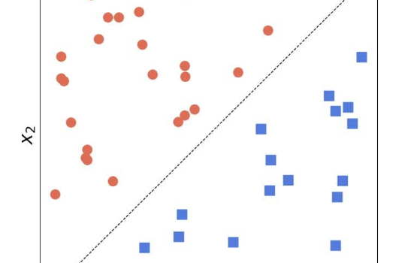

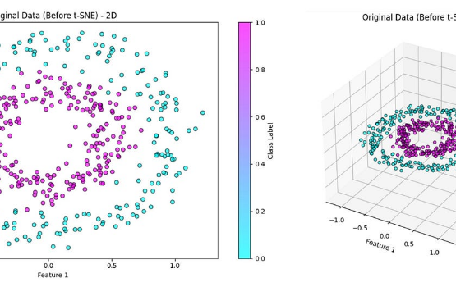
Linearly vs. Non-Linearly Separable
Linearly Separable
Non-Linearly Separable

Slide 68
The XOR Problem
The Perceptron's Downfall
The XOR (Exclusive OR) gate outputs 1 if the inputs are *different*, and 0 if they are the *same*.
This data is not linearly separable.
A single perceptron cannot solve the XOR problem.

Slide 69
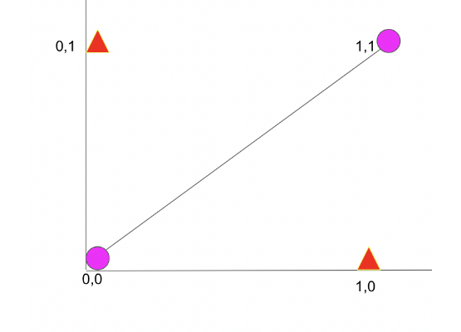
The XOR Problem (Visualized)
No Single Line Works!
x1 | x2 | t
0 | 0 | 0
0 | 1 | 1
1 | 0 | 1
1 | 1 | 0

Slide 70
Significance of the XOR Problem
Limitations of a Single Neuron
Minsky & Papert (1969) proved the Perceptron's limitations, stalling ANN research (the "AI Winter").
It showed that single neurons can only solve linearly separable problems.
The solution is to use multiple layers of neurons (a Multi-Layer Perceptron, or MLP).

Slide 71
Part 12: Summary & Next Steps
Reviewing the Perceptron

Slide 72
Perceptron Summary
The 4 Components (Perceptron)
Data: Labeled (x, t) pairs (e.g., truth tables).
Model: A single neuron with a step activation function.
Objective Function: Minimize the error (t - ŷ).
Learning Algorithm: The Perceptron Learning Algorithm (PLA).

Slide 73
Convergence & Failure
When it Works, When it Fails
Success: The PLA will converge in a finite number of steps if the data is linearly separable.
Failure: The PLA will fail to converge (it will loop forever) if the data is not linearly separable.

Slide 74
Practice Problems
[ASSIGNMENT-REQUIRED]
Apply the Learning Algorithm
Manually apply the Perceptron Learning Algorithm (like the NOT gate example) for:
The AND gate.
The OR gate.
The NOR gate.
The NAND gate.
Implement a simple Perceptron in Python (NumPy) to solve these.

Slide 75
References
Further Reading
T1 (D2L): Chapter on Linear Networks / Single-Layer Networks.
R1 (Goodfellow): Chapters 1-6 provide excellent background.
Rosenblatt, F. (1958): "The Perceptron: A Probabilistic Model..."
Minsky & Papert (1969): "Perceptrons" (Historical context).

Slide 76
Questions?

Slide 77
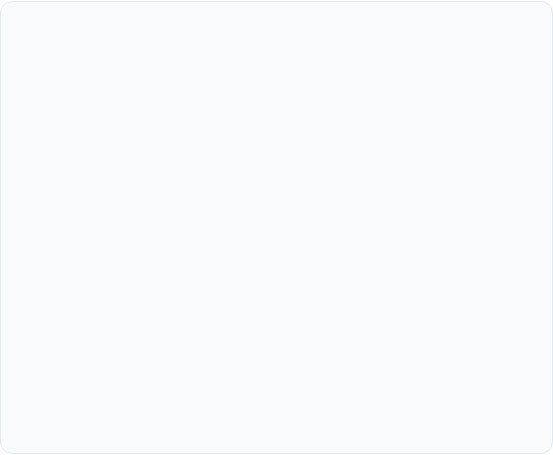
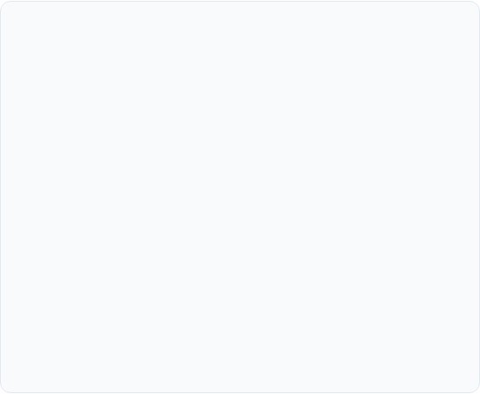
Module 2 Checklist
Assignment-Required Concepts
Textbook & Appendix
Artificial Neuron (Forward Computation)
T1 (D2L): Chapter on Linear Models R1 (Goodfellow): Chapters 1-6 Appendix Code:
Perceptron Introduction & Model (Step Function)
Logic Gate Modeling (AND, OR, NOR, NAND)
perceptron_simple_demo.py
Perceptron Learning Algorithm (Formulas)
perceptron_logic_gates.py
PLA Numeric Walkthrough (NOT gate)
perceptron_learning_rule_numeric.py
Linear Separability
perceptron_linear_separability_visualization.py

Slide 78
Appendix: Code Suite
NumPy Code for Module 2 Concepts

Slide 79
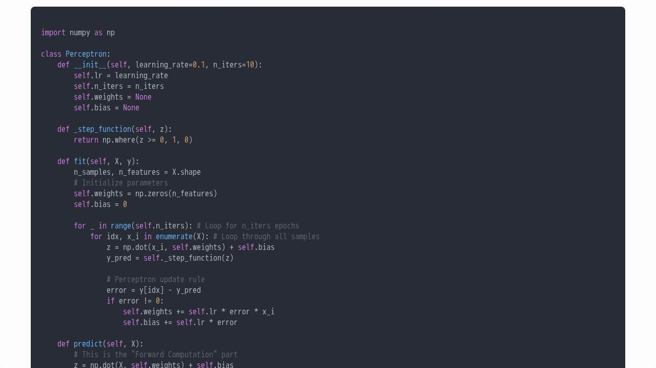
Appendix: perceptron_simple_demo.py

Slide 80
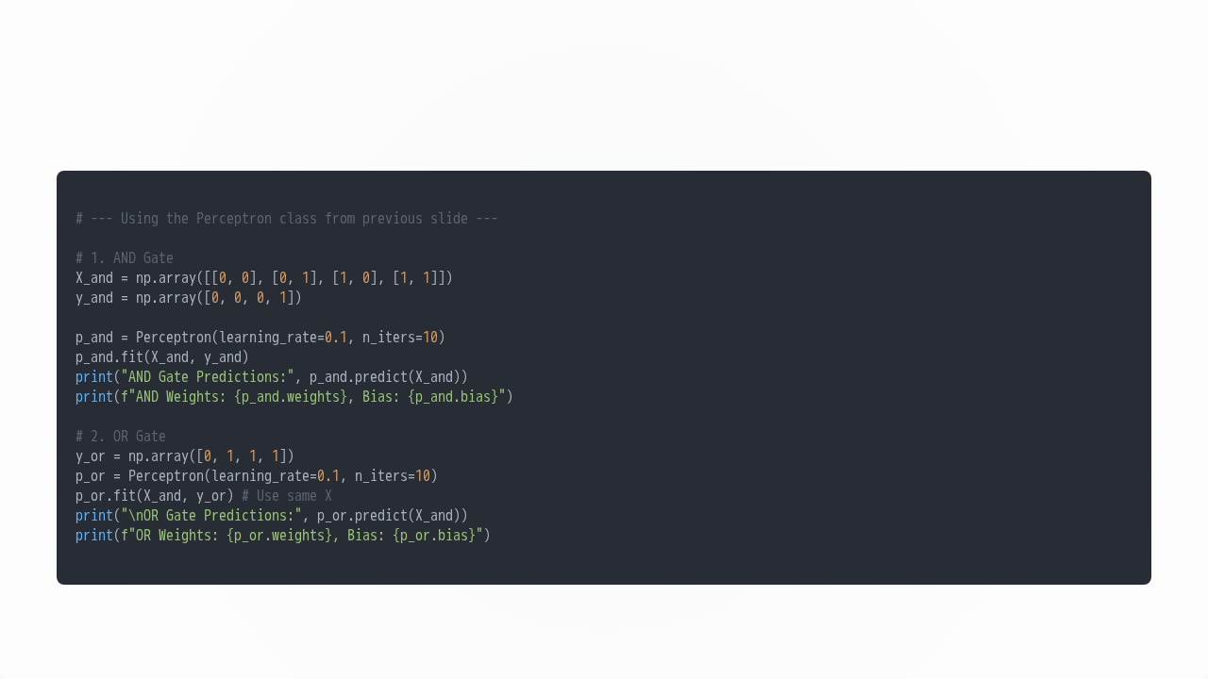
Appendix: perceptron_logic_gates.py

Slide 81
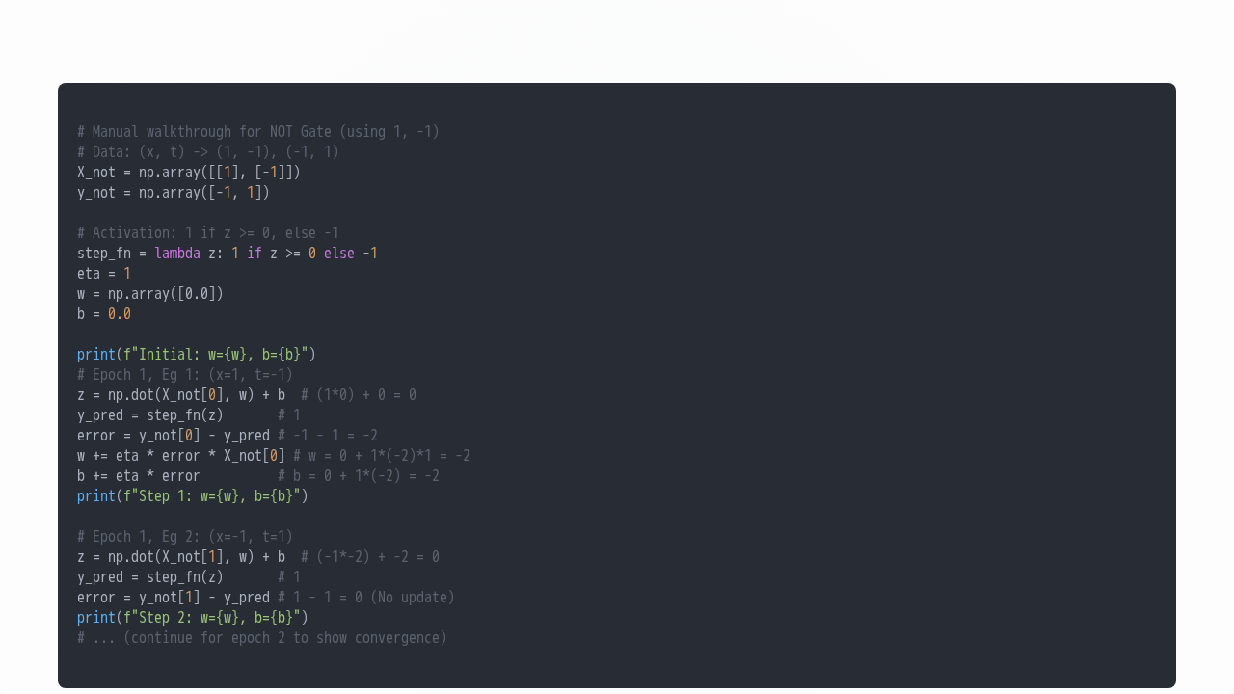
Appendix: perceptron_learning_rule_numeric.py

Slide 82
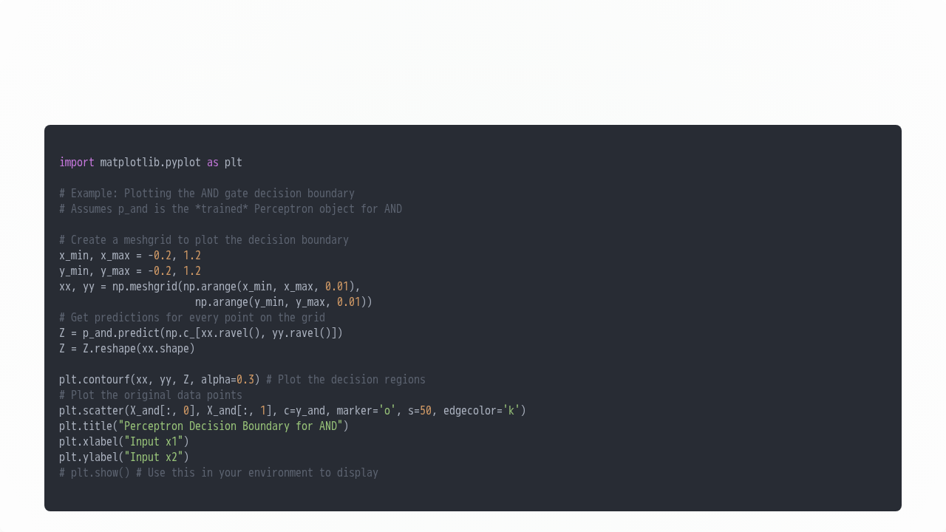
Appendix: perceptron_linear_separability_visualization.py

Slide 83







Image Sources
https://images.stockcake.com/public/1/4/5/145a4b4b-a7d7-4d2b-9ff6-b62e99d8ef7c_large/illuminated-neural-network-stockcake.jpg
Source: stockcake.com
https://cdn1.byjus.com/wp-content/uploads/2019/04/Neurons-Nerve-Impulses.png
Source: byjus.com
https://towardsdatascience.com/wp-content/uploads/2021/12/1hkYlTODpjJgo32DoCOWN5w.png
Source: towardsdatascience.com
https://media.geeksforgeeks.org/wp-content/uploads/20240719175629/Input-Layer-in-an-ANN.webp
Source: www.geeksforgeeks.org
https://i.sstatic.net/Hjn3M.png
Source: stats.stackexchange.com
https://scipython.com/media/old_blog/logistic_regression/decision-boundary.png
Source: scipython.com

Slide 84




Image Sources
https://www.baeldung.com/wp-content/uploads/sites/4/2022/01/linearly-separable.jpg
Source: www.baeldung.com
https://miro.medium.com/v2/resize:fit:1400/1*PF5VftEJiPWdErQyY6fLLQ.jpeg
Source: medium.com
https://analyticsindiamag.com/wp-content/uploads/2022/06/image-207.png
Source: analyticsindiamag.com

